Slide 1



Assessment For Business Growth
October 17, 2020

Slide 2





Mystery Inc. – Meet the team
Soumya
Patra
Sahil
Gandhi
Rohan
Gupta
Cyril
Johnson
Jaswinder
Singh

Slide 3


Background
Orange Cars, Oklahoma based economy car rental company faces heavy losses due to COVID 19 outbreak and measures to contain it.
Objective for Mystery Inc, is to formulate strategy to regain the losses incurred during the pandemic by formulating strategy based on customer lifetime value

Slide 4

Today’s Agenda
Customer Lifetime Value
Retention rate and margin
Customer segmentation
What IF analysis
Recommendation

Slide 5
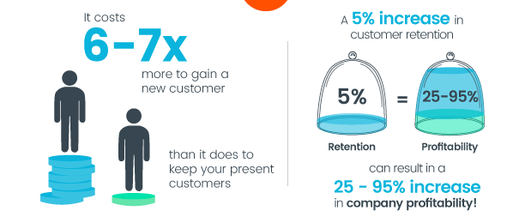

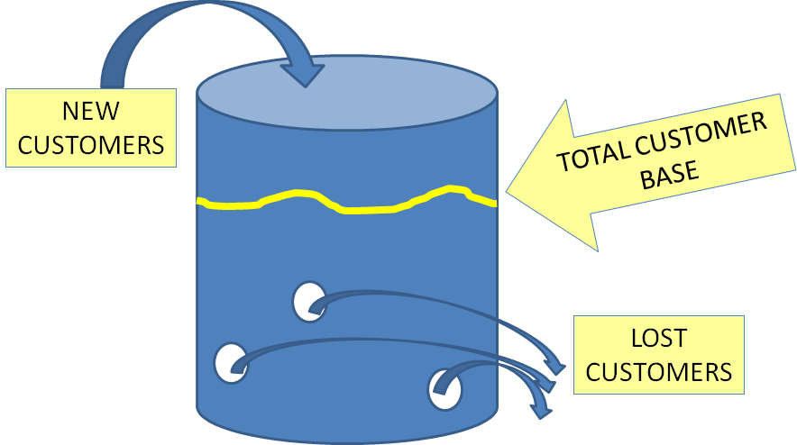

Acquisition Vs. Retention
Customer Lifetime Value
Leaky Bucket
COST
PROFIT
https://www.act.com/en-uk/what-is-customer-retention

Slide 6







Customer Lifetime Value
Customer Lifetime Value
CLV is a measurement of how valuable a customer is to your company, not just on a purchase-by-purchase basis but across the whole relationship.
Customer Future Value
Customer Historic Value
Customer Future Value
Dependent on:
Predicted Margin
Predictive Churn

Slide 7





Business Strategy
Customer Lifetime Value
Identify customer with high CFV so that their retention can be increased
Identify customer with low CFV so that they can be upgraded
Existing
Customer Future Value
Identify customer with high CFV so that targeted marketing can be done to them
Acquisition

Slide 8


Calculating customer future value
Customer Lifetime Value
Churn Modeling
Margin Modeling
Predicted Churn
Predicted Margin
Customer Future value

Slide 9
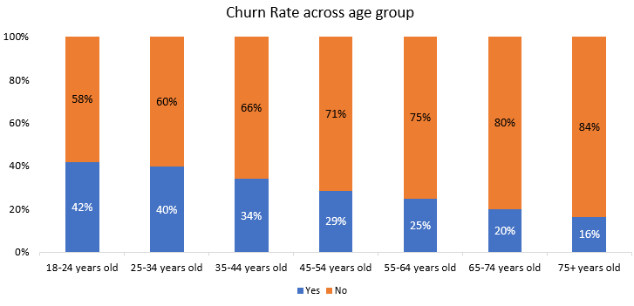
Change of churn rate across demographics
Retention rate and margin

Slide 10
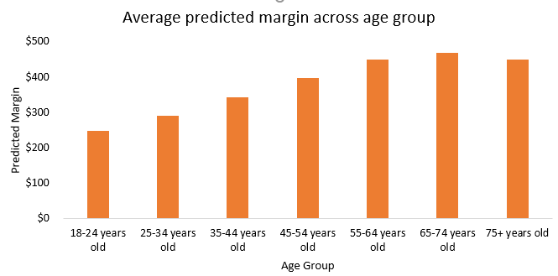
Predicted margin across age group
Retention rate and margin

Slide 11
Customer Churn Factors
Retention rate and margin
Factors | Churn (Yes) | Churn (No)
Number of months since last (most recent) transaction | 6 months* | 2 months*
Number of months since first transaction | 45 months* | 72 months*
Revenue amounts for the most recent 36 months in the observation window | $260* | $680*
Number of times marketing mail was sent to customer in last 36 months | 11* | 22*
Number of responses to marketing contacts in last 36 months | 2.6* | 4.7*
Average interval between purchases | 7.4 months* | 4.1 months*
Purchases of add-on products, using credit card and electronic transfer payment, within last 36 months | 43%# | 45%#
Number of times customer was called by the call center within the last 36 months | 2.4* | 1.7*
Number of times customer called into the call center within the last 36 months | 5.7* | 8.3*
Value denotes average of all customer in that segment
# Value denotes percentage of total expenditure paid using credit card and electronic transfer for all add on product purchases

Slide 12
Customer Margin Factors
Retention rate and margin
Factors | Low Margin* | High Margin*
Purchase amounts for the most recent 36 months in the observation window | $281.1 | $1,944.5
Average interval between purchases | 7 months | 3 months
Total Amount of Purchases of add-on products in lifetime | $839.4 | $5,817.5
Number of months since first transaction | 48 months | 80 months
Number of orders in last 36 months | 5.3 | 7.1
Number of times customer was called by the call center within the last 36 months | 1.7 | 2.8
Number of times customer called into the call center within the last 36 months | 9.9 | 5.3
Value denotes average of all customer in that segment

Slide 13






Customer segment based on retention rate and margin
Customer Segmentation
High
High
Question
Marks
(17%)
Stars
(33%)
Question Marks
Stars
Retention Likelihood
Retention Likelihood
Dogs
(34%)
Cash-cows
(17%)
Dogs
Cash-cows
Margin $
High
Margin $
High

Slide 14
Customer lifetime value for 4 segments
Customer Segmentation
High
High
+$1,371
Question
Marks
($371)
Stars
($1,742)
Question Marks
Stars
+$260
+$1,004
Retention Likelihood
Retention Likelihood
Dogs
($111)
Cash-cows
($738)
Dogs
Cash-cows
+$627
Margin $
High
Margin $
High

Slide 15


Customer Profile
Customer Segmentation
Segment | Majority Age Group | Email ID Provided | Avg Call In | Avg Call Out | Average Purchase Interval | Customer since* | Last transaction*
 | 55-64 years | Yes (55%) | 6.1 | 3.1 | 1.6 months | 7.5 years | 1.1 months
 | 55-64 years | Yes (54%) | 4.2 | 2.2 | 5.9 months | 5.2 years | 4.1 months
 | 55-64 years | Yes (53%) | 11.9 | 1.9 | 4.4 months | 4.9 years | 1.2 months
 | 45-54 years | No (53%) | 9.1 | 1.5 | 8.1 months | 3.6 years | 4.9 months
* - Value denotes average of all customer in that segment

Slide 16
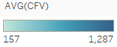
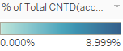
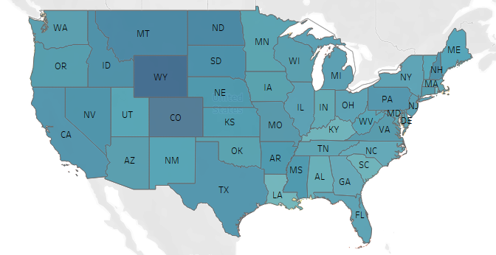
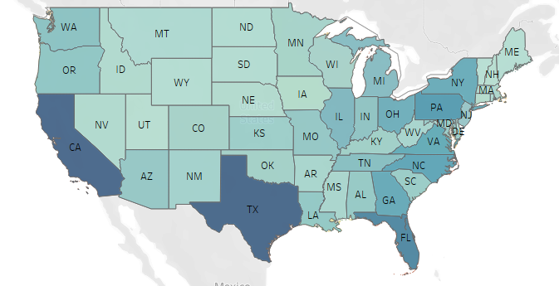
Customer Profile
Customer Segmentation
Average of Customer Future Value
Customer count
0%
9%
Distribution of Customer Future Value across states
Distribution of Customer counts across states

Slide 17


Shift in customer to higher quadrants
What IF analysis
$192,996,439
$217,816,145
$24,819,706
Number of customers |  | Margin
 |  | Low | High
Retention | Low | 78,625 | 40,462
 | High | 40,190 | 80,079
Number of customers |  | Margin
 |  | Low | High
Retention | Low | 55,038 | 46,186
 | High | 45,955 | 92,177
15% shift in customer across quadrant
$10 M increased profit due to 15% shift across customer segments
CFV |  | Margin
 |  | Low | High
Retention | Low | $111 | $738
 | High | $371 | $1,742
CFV |  | Margin
 |  | Low | High
Retention | Low | $111 | $738
 | High | $371 | $1,742
Revenue |  | Margin
 |  | Low | High
Retention | Low | $29,169,875 | $70,484,804
 | High | $4,461,090 | $59,098,302
Revenue |  | Margin
 |  | Low | High
Retention | Low | $6,109,163 | $34,085,600
 | High | $17,049,398 | $160,571,986

Slide 18
Shift in customer to higher quadrants
What IF analysis
Shift in customer across quadrant | Revenue (CFV x Number of customers) | Percentage increase from baseline | Number of customers
 |  |  | Dogs | Question Marks | Cash Cow | Stars
Baseline | $192,996,439 |  | 78,625 | 40,190 | 40,462 | 80,079
5% | $201,269,675 | 4% | 70,763 | 42,370 | 42,112 | 84,112
10% | $209,542,910 | 9% | 62,900 | 44,278 | 44,034 | 88,144
15% | $217,816,146 | 13% | 55,038 | 46,186 | 45,955 | 92,177
20% | $226,089,382 | 17% | 47,175 | 48,095 | 47,877 | 96,209

Slide 19




Recommendation
Recommendation
Convert cash cow segment to star segment
Cash cow has customer future value closest to that of star segment so it's easier for them to convert
The profit based on 10% annual conversion is $8,000,000
Maintain star segment's retention though satisfaction
They have the highest retention rate of 99%
Improve service or include new features based on their feedback
Encourage customer to engage in email communication
Do targeting marketing for the young age group
They have the highest churn rate of 42% across all the age group
Even though they would be initially in dog segment, we can push them towards question mark segment
The profit based on 10% annual conversion is $4,000,000

Slide 20
THANK YOU

Slide 21
APPENDIX

Slide 22
Terminology
Customer profit measures the past while CLTV looks forward
Customer profit is calculated through careful reporting and summarizing the results of past activity
CLTV involves forecasting future activity, it is the present value of the future cash flow attributed to the customer relationship
$$CLTV=Margin x \frac{Retention Rate (\%)}{1+Discount Rate \left(\%\right)−Retention Rate (\%)}$$
Profitability for the customer = Revenue from a customer – Cost to serve each customer
*https://www.slideshare.net/emagine/customer-lifetime-value-33070281

Slide 23
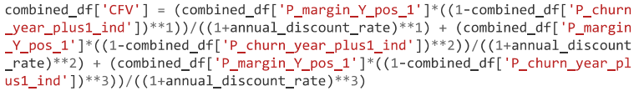
Models Used
Likelihood to Churn: Logistic regression, gradient boosting
Best Model: Gradient boosting (70% accuracy)
Future Margin: Logistic regression, gradient boosting
Best Model: Gradient boosting (70% accuracy)
Formula of CFV
*https://www.slideshare.net/emagine/customer-lifetime-value-33070281

Slide 24
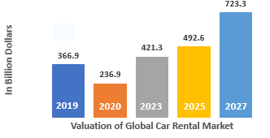
Acquire new customers
Discuss on strategy
To understand the potential of acquiring new customers, we need to confirm the market should have the potential for company to grow and scope of growth
The top opportunities in the market will arise in the passenger car rental segment, which will gain $31.9 billion of global annual sales by 2023, adding to the global car rental market size.
Amidst the unprecedented outbreak of coronavirus, governments across the world are advising people to stay indoors and practice social distancing, to reduce the spread of the pandemic. This has decreased short term potential growth opportunities for the car rental industry.
2019
2020
2023
2025
2027
https://www.globenewswire.com/news-release/2020/09/08/2089843/0/en/Companies-In-Automobile-Rental-And-Leasing-Market-Expand-Customer-Base-By-Acquiring-Businesses-In-More-Countries.html

Slide 25
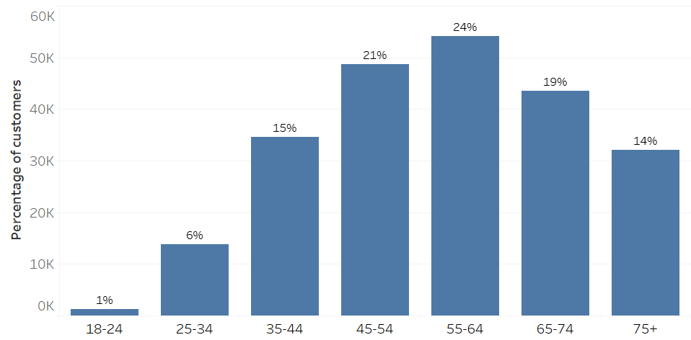
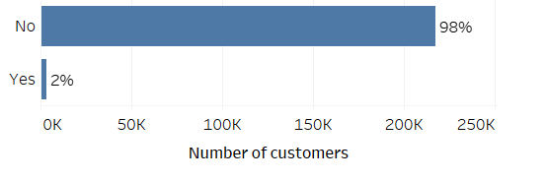
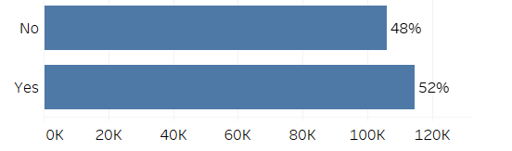
Know your customers
Know your customers
Distribution of customers based on Age
Distribution of Spanish speaking customer
Distribution of customers with Email preference

Slide 26
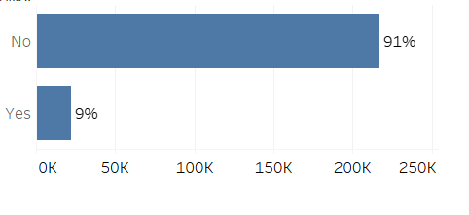
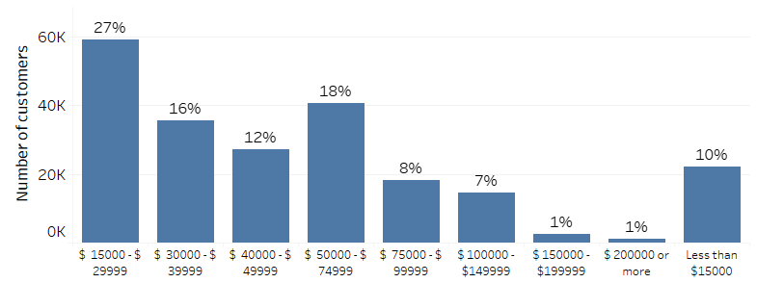
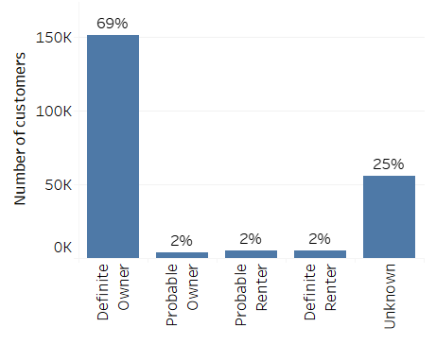
Know your customers
Know your customers
Distribution of fixed income customers
Distribution of income of customers
Own or rent the residence

Slide 27
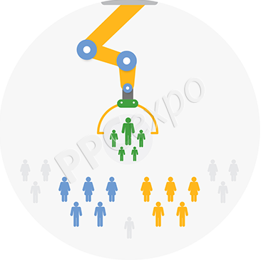

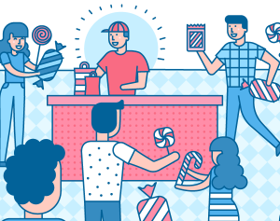

Acquire new customers
Discuss on alternate strategy
As we see there is a potential in the market, so we must introduce new strategy to attract new customers
Target the right customer
Promote your brand – increase visibility
Provide correct incentives to the customers
Improve customer services considering the changes due to COVID 19

Slide 28





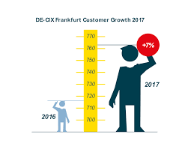
Improve customer retention
Discuss on alternate strategy
Based on customer profitability, each customer can be assigned to either of the four groups:
Tier 3 : Loyal
High average profit but low interaction
Might be targeted for growth
Tier 1: Reward
Most valuable customers
Value what you do the most
May not be price sensitive
All customers are not equal
Tier 4 : Fire
Loses money on servicing these customers
If can’t be promoted, prices should be increased
Tier 2 : Grow
Middle to low profits
Might be targeted for growth
Develop a marketing and sales strategy for each type of customer
*https://www.slideshare.net/emagine/customer-lifetime-value-33070281

Slide 29
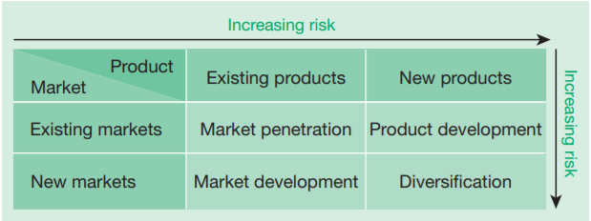
Recommendation - Strategy
Next steps
Based on the Ansoff’s Matrix, we can classify our objective as market penetration
Market Penetration
Cross selling and Up selling
Selling existing products to new customers in same market
Modest product refinements to widen the range of existing products
Increase in promotion

